Slide 1
Analyzing Housing and Income Data for MLB Expansion
Team 116

Slide 2





The Team
Josh Mayanja
Yutai Liu
Warren Spann
Anthony Palmeri
Jonathan Martin
Solutions Consultant, Nuix NLP
Project Analyst, Insight
Enterprise Data Analyst
Data Analyst, Business Intelligence
Business Intelligence Consultant

Slide 3
The Problem

Slide 4

MLB Expansion
MLB is exploring expansion
Attendance is a strong indicator of franchise health
Higher attendance → Higher revenue
Finding ideal markets is difficult
Multiple new markets could look similar on paper
Could non-traditional markets be overlooked that are actually the best option
Multiple stakeholders with billions of dollars on the line
Cost to start a new team is at least $2.2 billion (1)
A successful franchise will generate in billions
A failed franchise would ravage the entire market
“Manfred’s $2.2 Billion MLB Expansion Fee on the High Side, at Least for Now.” Yahoo!, 3 May 2021, www.yahoo.com/video/manfred-2-2-billion-mlb-095515953.html?guccounter=1&guce_referrer=aHR0cHM6Ly93d3cuZ29vZ2xlLmNvbS8&guce_referrer_sig=AQAAAL4a-Ocq4BcSf9OQjHqZzT_TUBzNgWfTWI1znfMU-XRHCRKFRBDSMr87D5_kfj5osaPpcAUjoYWM2yv-IKoNwkQdMctGDvCDo9A3aLa_6V6A5JMpCs5m5snATtr86dIyqnUvAbcOKBY9lGeG6zouW-LyF22CXiElkV3rUIOuFfBA#:~:text=Major%20League%20Baseball%20commissioner%20Rob,be%20at%20least%20%242.2%20billion.

Slide 5

Primary Research Question: Can MLB attendance be predicted based on income data?

Slide 6

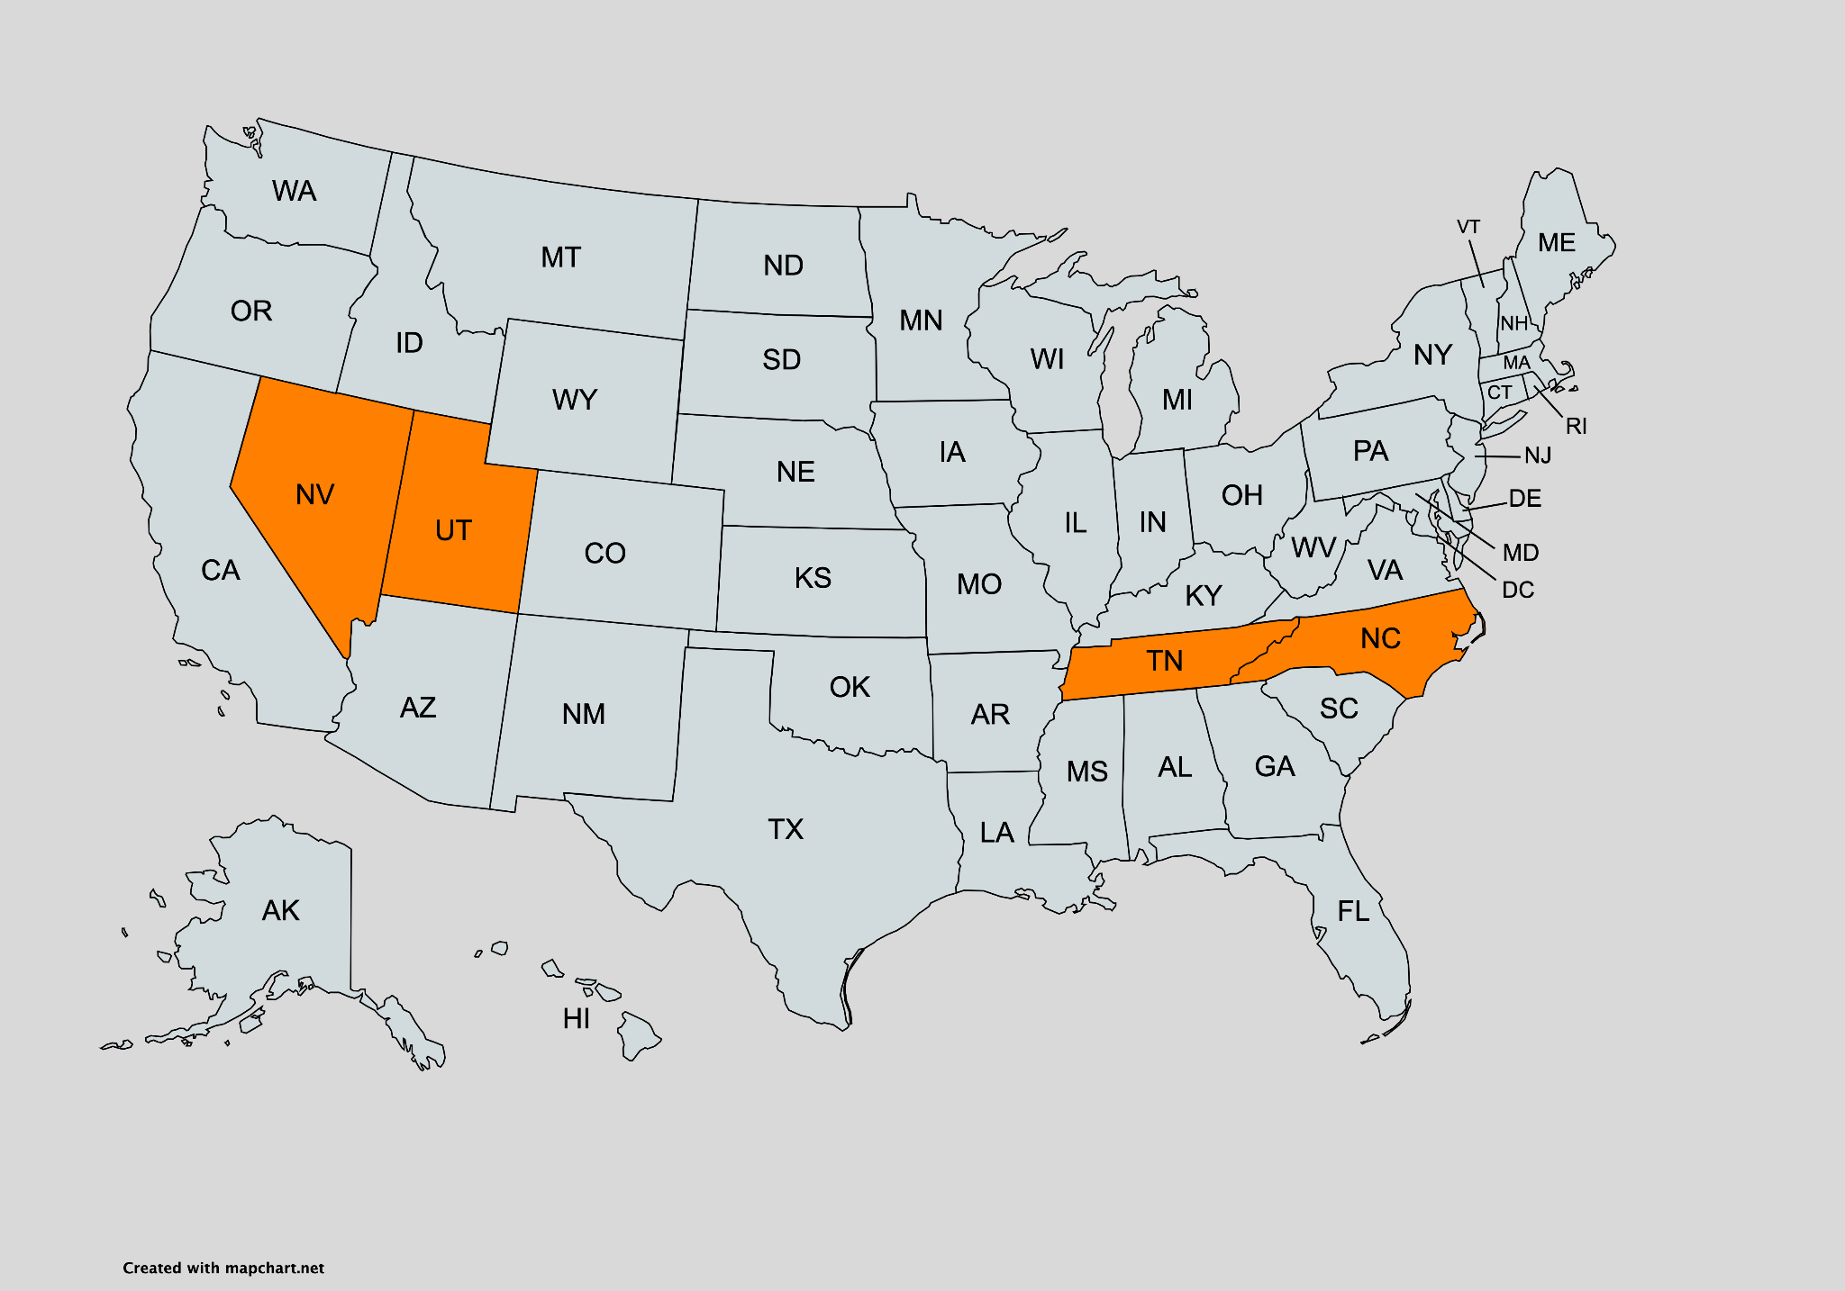
Initial Hypothesis
We believe our model will predict one of four cities to have the highest attendance numbers
Nashville, TN
Charlotte, NC
Las Vegas, NV
Salt Lake City, UT
Tens of potential markets across the United States will be tested
A non-traditional market could be likely to have the highest predicted attendance
3 models will be created to explore this, the best one will be used for predictions

Slide 7
Datasets and Cleaning

Slide 8
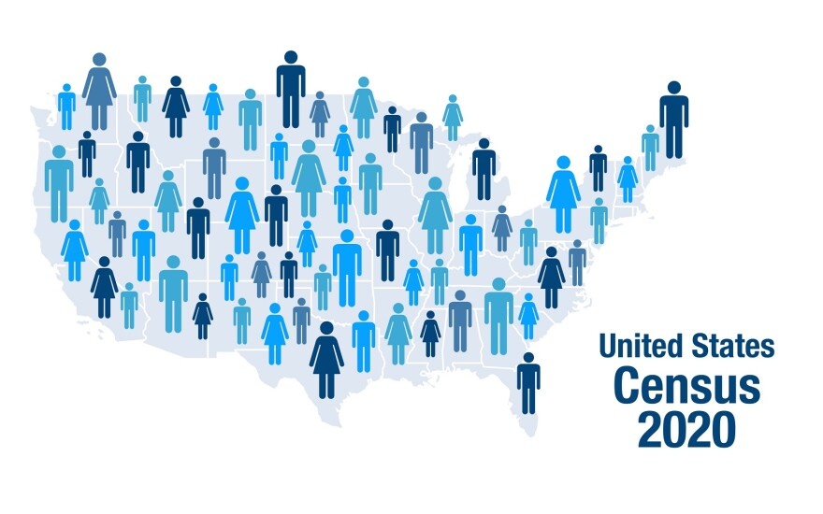
Census and MLB Datasets
Census Income Dataset
364,998 rows by 110 columns, by far our largest dataset (10 years worth of census data)
Contains data points for each zip code across that ten year span on 110 features based on household income and home value data
Zillow
Zipcodes used from the census data to define metropolitan areas for grouping
**Market defined as the metropolitan area for the city in which the MLB franchise is located
MLB Attendance Numbers
162 rows (how many games in a season) by 22 columns
Cumulative attendance numbers per home game per year were calculated using this dataset
MLB Team Valuations
30 rows by 11 columns
Contained data on estimated team valuations from 2011-2021
Valuation data from Wikipedia and Forbes
Ultimately not used due to inconsistent predictions

Slide 9
Dataset Cleaning
Datasets were merged using defined MLB metropolitan areas (Zillow) and cumulative attendance each year (MLB Attendance Numbers)
COVID Year 2020 was removed
Merged dataset contained 10 data points for each market (one for each year)
Same process was utilized to define 25 potential new markets for predicting
Additional attributes added included dome stadiums and number of teams in a market (New York)
Dataset was split for training and testing
276 total data points
Utilized an 80/20 split for training and testing sets
Rotation was used to split data instead of random selection to avoid skewing
Final splits contained each year represented 20 times in training and 5 times in testing sets

Slide 10
Exploratory Data Analysis

Slide 11
Initial EDA
Distributions of the Attributes
Skewed to the right (transformations were explored if the model required a normal distribution)
Wide spread (variance reduction transformations were also explored)
Small Market vs. Large Market Teams
Correlation Analysis
All variables were tested in a correlation matrix
Error variables removed
Only certain variables showed moderate correlations with attendance
Data exhibited multicollinearity issues
Outlier Analysis
Outliers tested with quartile analysis as well as Z-scores
Approximately 20 outliers per column found
Concluded that outliers were representative of true data and not sampling errors

Slide 12
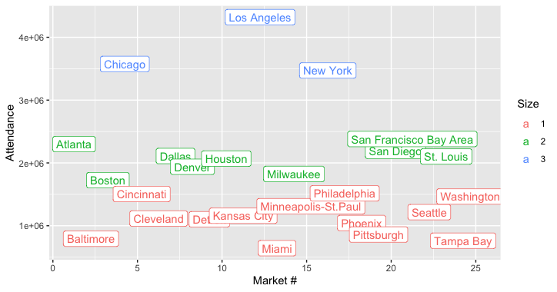
Attendance Clustering
K-means clustering using 2021 attendance data from 25 current markets.
3 clusters are formed (Large, Medium and Small Market).
Cluster means of 1,114,513, 2,071,340, 3,789,160 respectively.
Provides insights in comparing different markets based on the cluster group it is in.

Slide 13
Methods and Modeling

Slide 14
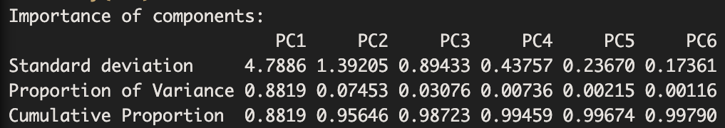
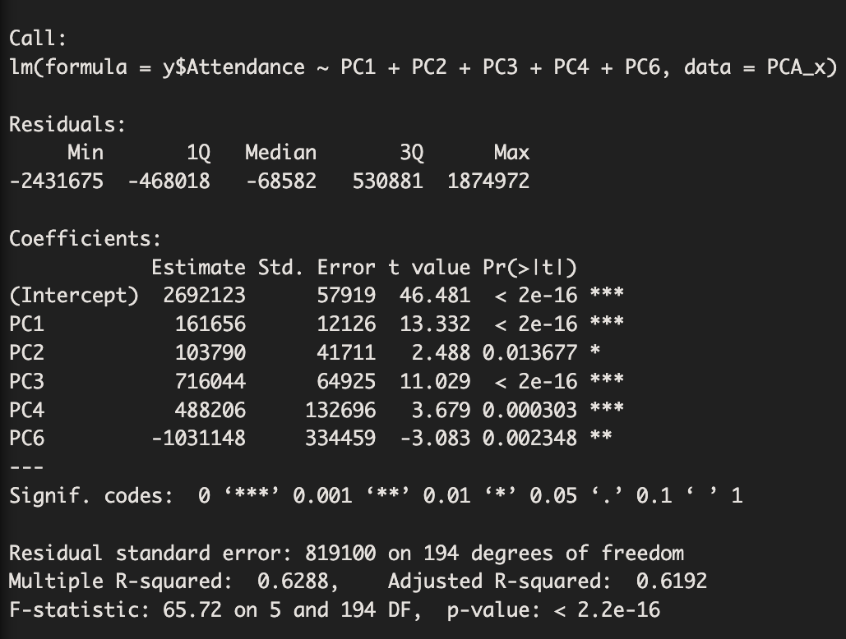
Linear Regression Model
Using initial EDA, the first model built was a linear regression
Difficulties meeting initial assumptions (multicollinearity, skewed distributions, ect.)
The model selected moderately correlated X variables with the predictor Attendance
To solve multicollinearity, implemented Principle Component Analysis compressed on 26 variables
Selected components cover 0.995575 of variance
Other methods attempted include Lasso Regression, Ridge Regression, and Boxcox and Logarithmic Transformations

Slide 15
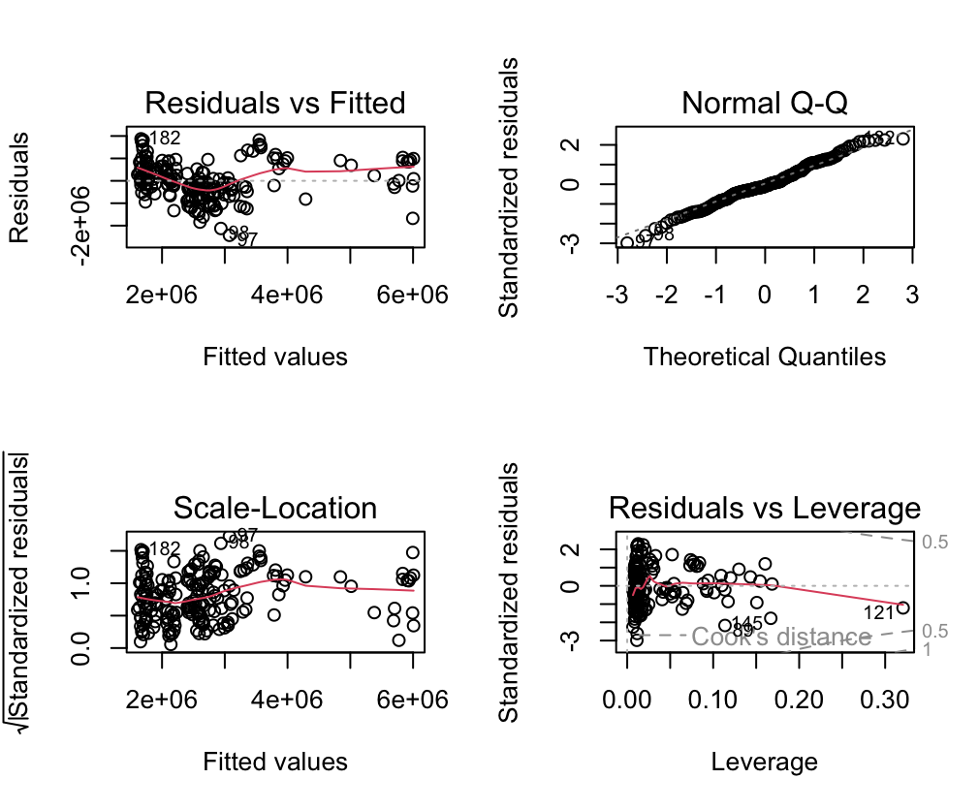
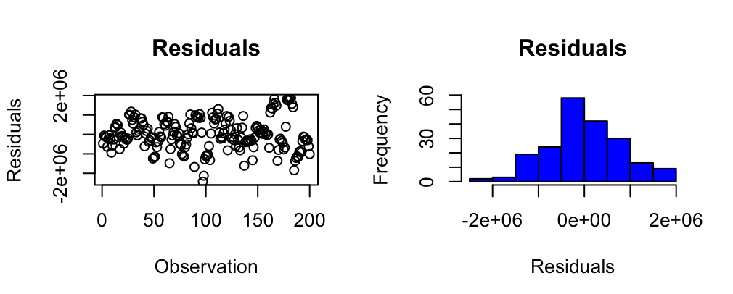
Linear Regression Training
Model Errors (Calculated on test data)
RSME: 831,613.2 or 10,266.83 per home game
MAE: 678,492.7 or 8,376.45 per home game
R²: 0.63
~$308,004.90 (roughly $30 a ticket per game) in missing or over-projected revenue

Slide 16
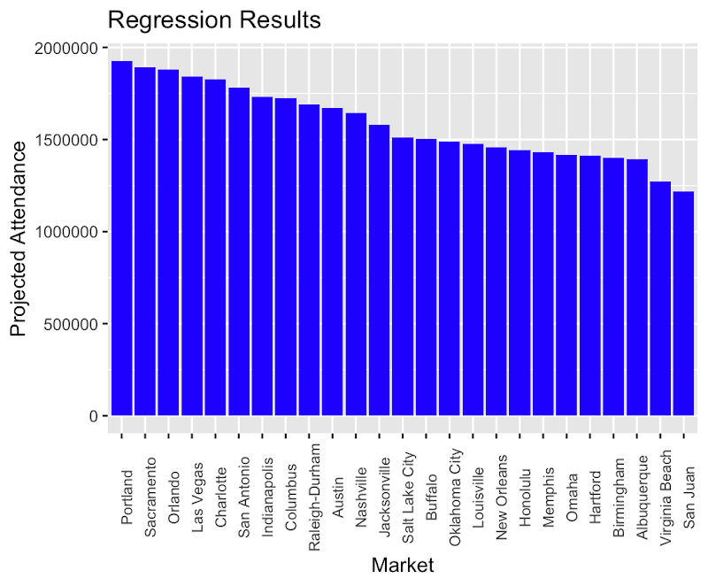
Linear Regression Results
Top 5 Projected:
Portland
Sacramento
Orlando
Las Vegas
Charlotte
Initial Hypothesis: Nashville, Charlotte, Las Vegas, Salt Lake City

Slide 17
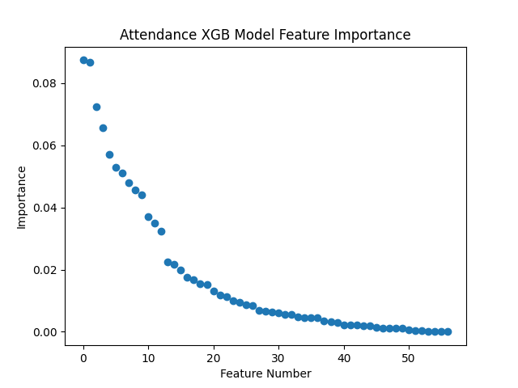
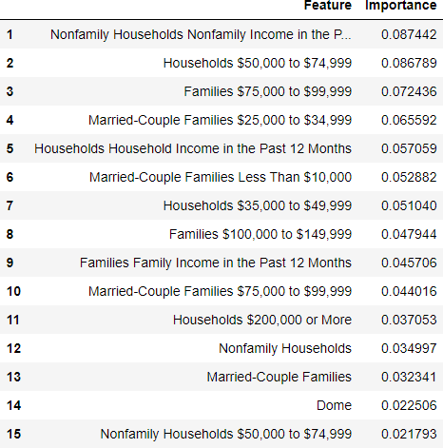
XGBoost Model
Ensemble learning algorithm using regression trees
Each tree is gradient boosted by the residuals of the tree before it
Built initial model trained on entire data to find feature importance
Elbow method was used to set a significance threshold of 0.02
15 predictors meet this significance level, all will be used
*Feature 1 is Nonfamily Households Nonfamily Income in the Past 12 Months

Slide 18
XGBoost Training
Grid search Cross Validation used to tune hyper parameters of model
5 folds
Found best parameters to be:
Gamma = 0
Learning Rate = 0.1
Max Depth = 3
Number of Estimators = 400
Trained new model on training set using these parameters

Slide 19
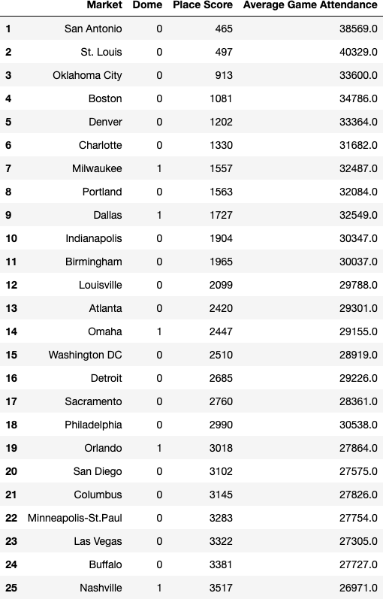
XGBoost Results
Relatively Low RMSE
RMSE = 268577.7372
RMSE per game = 3315.7745
Capturing most of the variability
R-squared = 0.8316
Adj. R-squared = 0.7345
Main metric → Place Score
Sum of the placings of a market’s average yearly attendance
Lower place score → Consistently higher attendance
Top 5 new markets:
San Antonio, TX
Oklahoma City, OK
Charlotte, NC
Portland, OR
Indianapolis, IN

Slide 20
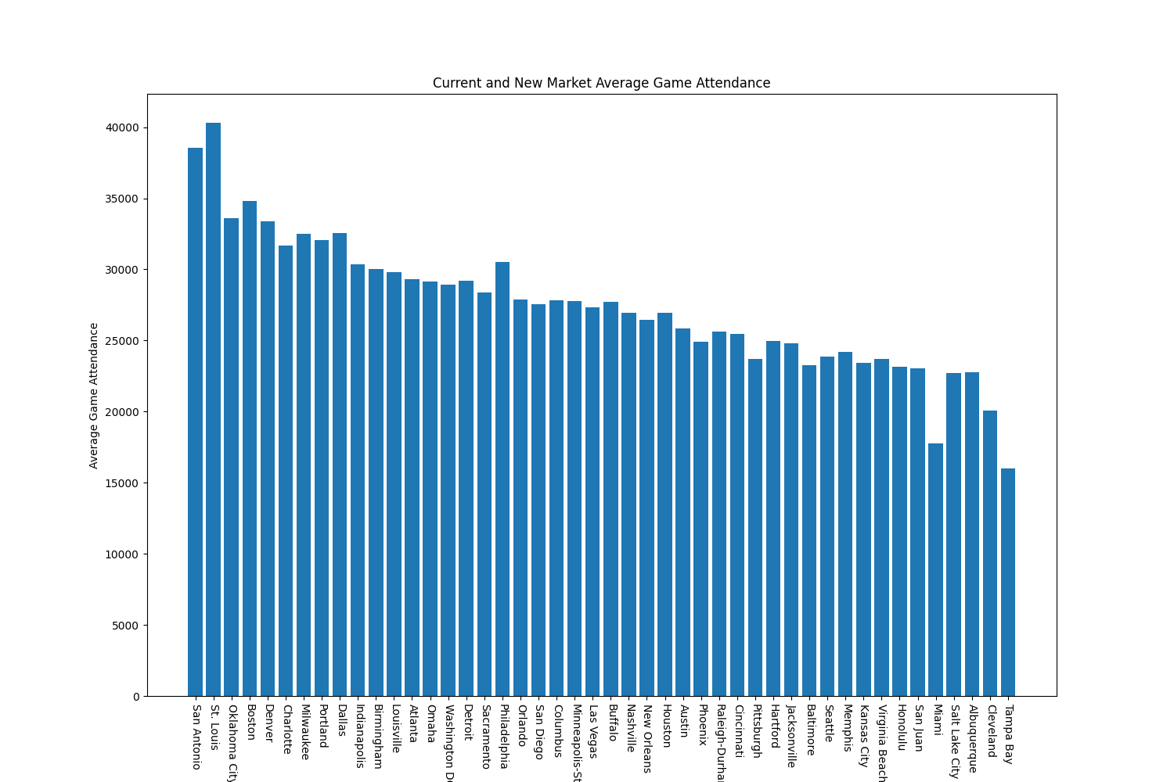
XGBoost Results (cont.)

Slide 21
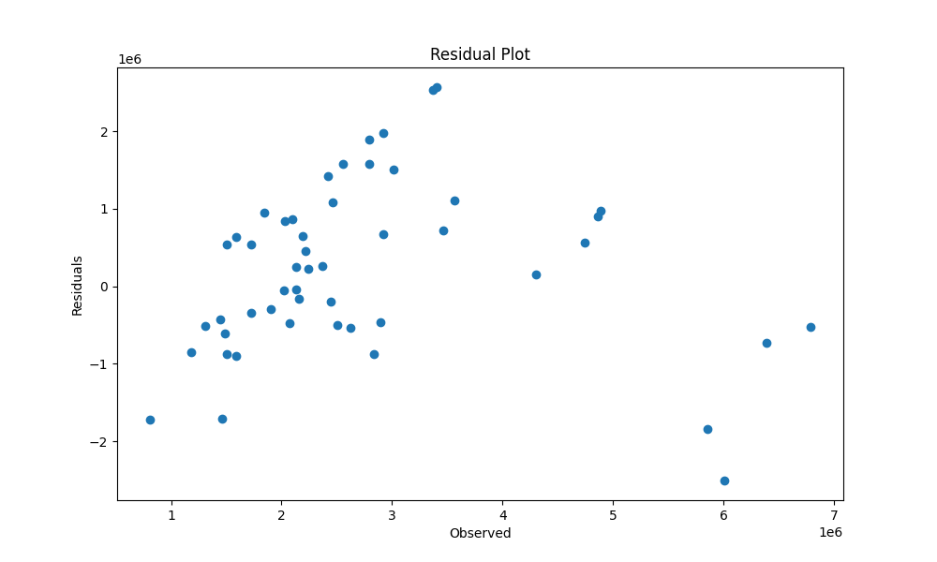
Deep Learning Model
An additional deep learning model was trained and tested with the tensorflow package.
A regression model was created with two hidden layers.
Adam optimization algorithm was used due to its efficiency and robustness.
Mean squared error was used as the loss function.
The model was trained with a batch size of 32 and for 50 epochs.
Notes:
Additional

Slide 22
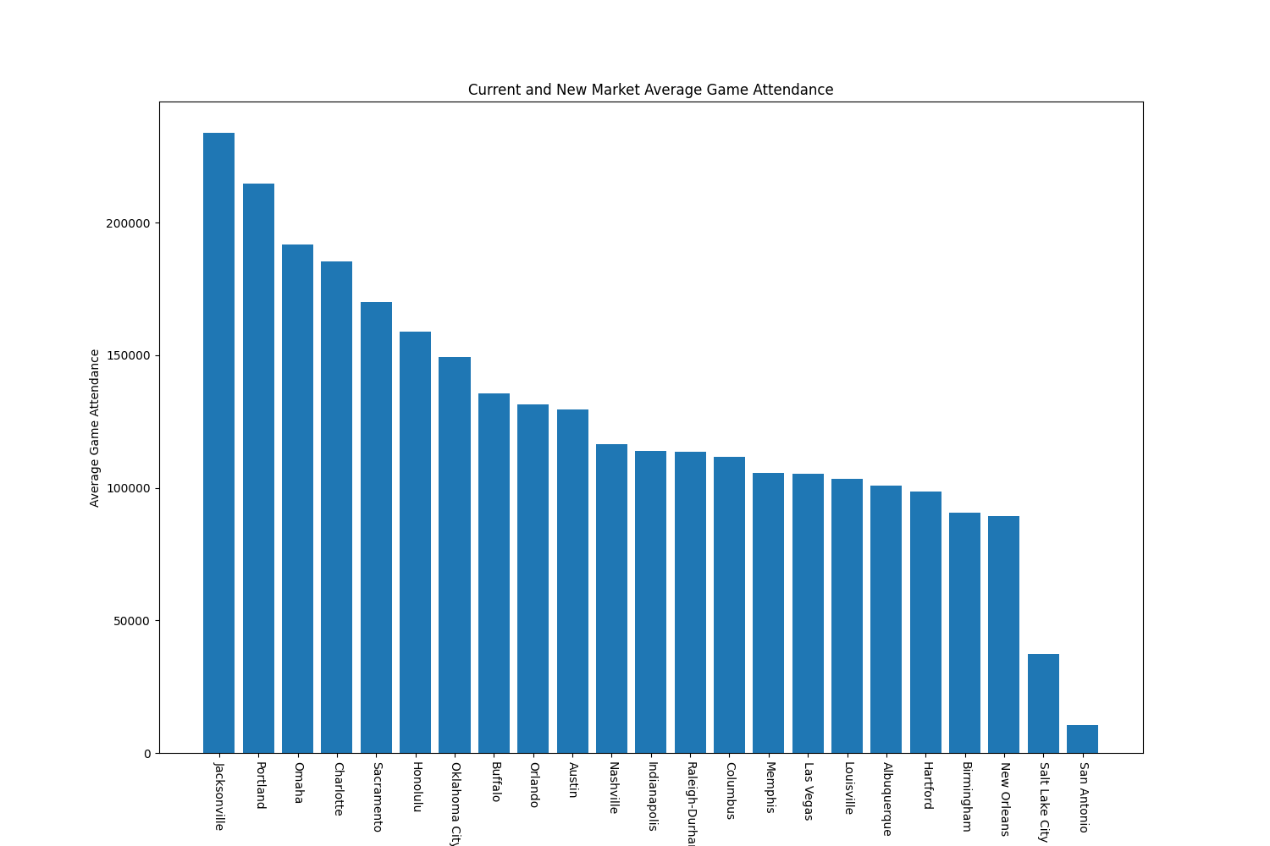
Deep Learning Results
Root Mean Squared Error of 1,185,855 (annual).
R-squared of 0.2554.
The model did seem to overestimate attendance on a per game basis as seen in the attendance plot.
Due to the low R-squared and high RMSE score, the xgboost and multiple linear regression models seem to be much better fits.

Slide 23
Final Results

Slide 24
Final Model Selection
Determined that it is possible to predict MLB attendance from housing income and valuation data
Comparing model performances:
Linear Regression
RMSE: ~ 10,266.83 per game
XGBoost
RMSE: ~ 3,315.77 per game
Deep Learning
RMSE: ~ 14,640.18 per game
All three models provided similar predictions and insights for each potential new market
Consistency provides extra confidence that predictions are strong and reliable
XGBoost model selected as final model for predictions
Based on low margin of error and high accounting of variance relative to the other models

Slide 25
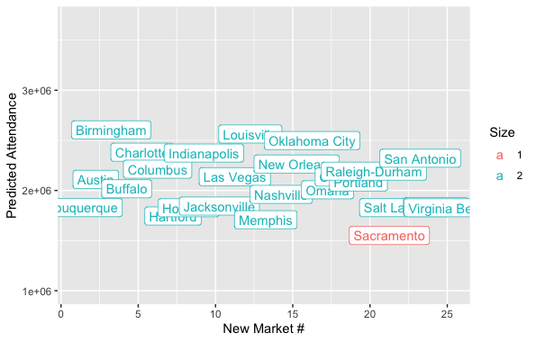
Final Clustering Results
Results from the XGBoost model were added to the existing market clusters from EDA
All markets except Sacramento were found to be mid-sized markets
Promising as this exposes the MLB to large amounts of new fans and revenue in each new market prospect

Slide 26
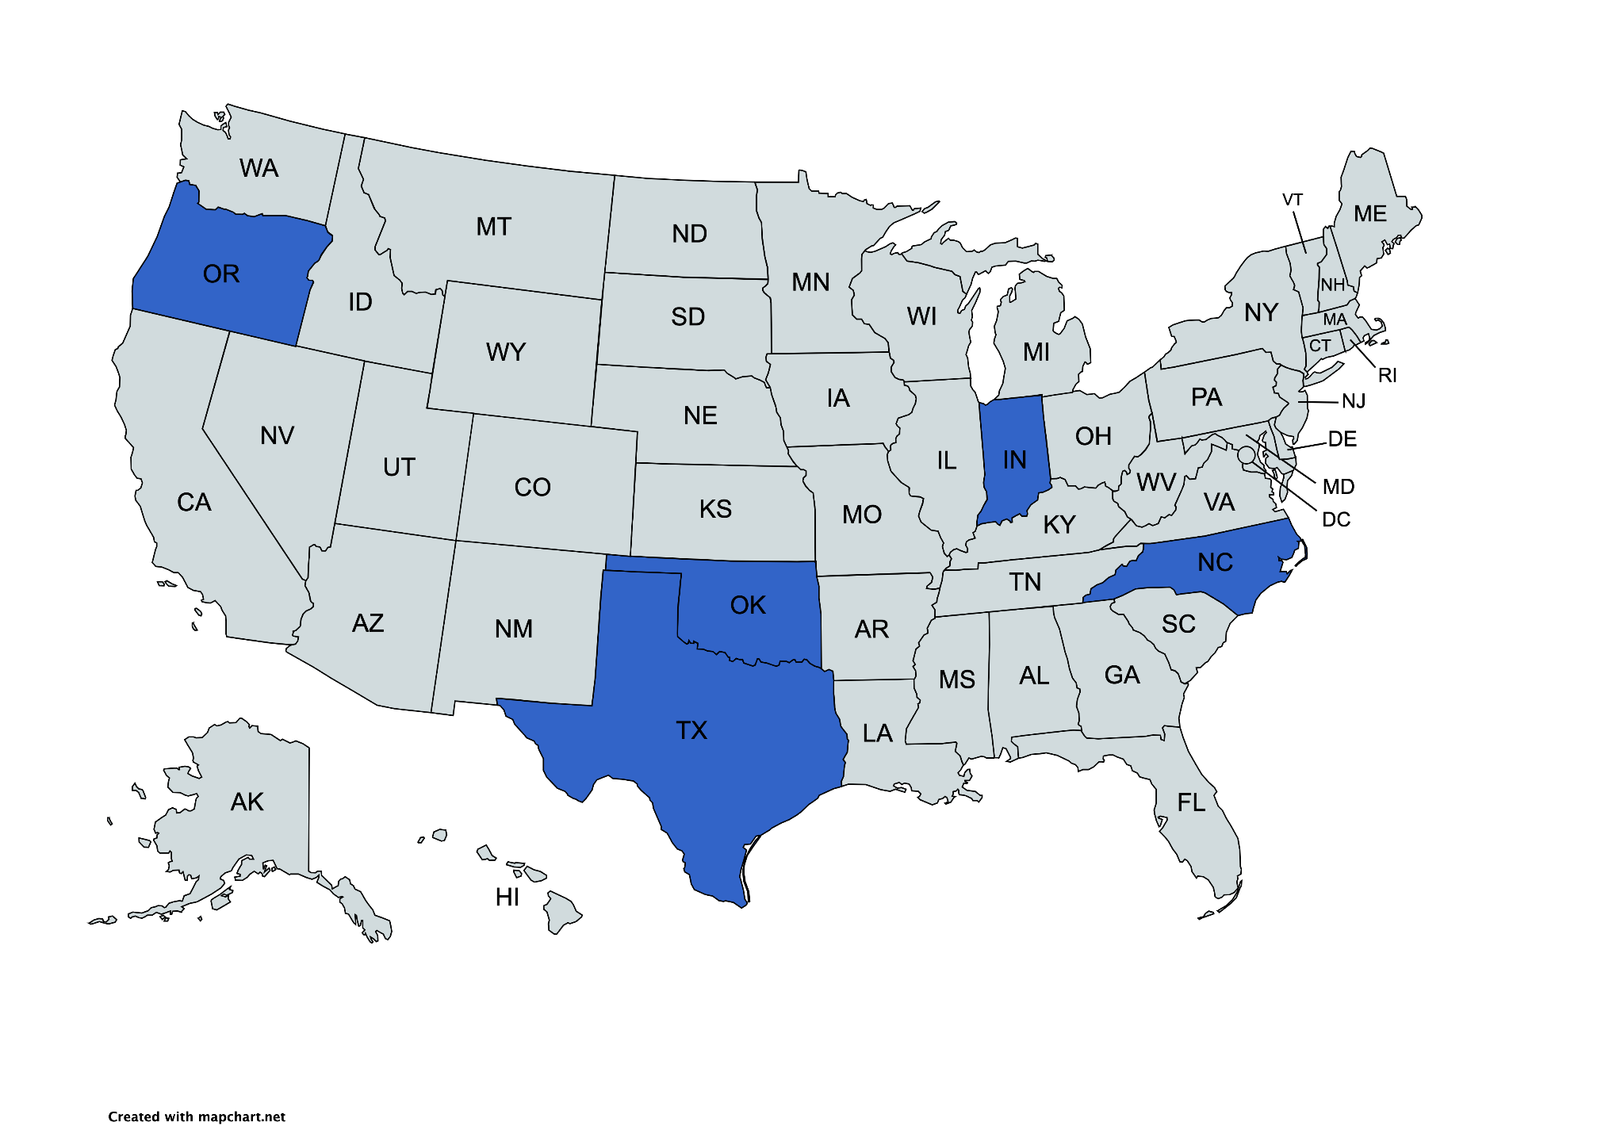
Final Predictions
Top 5 New Markets:
San Antonio, TX
Oklahoma City, OK
Charlotte, NC
Portland, OR
Indianapolis, IN

Slide 27
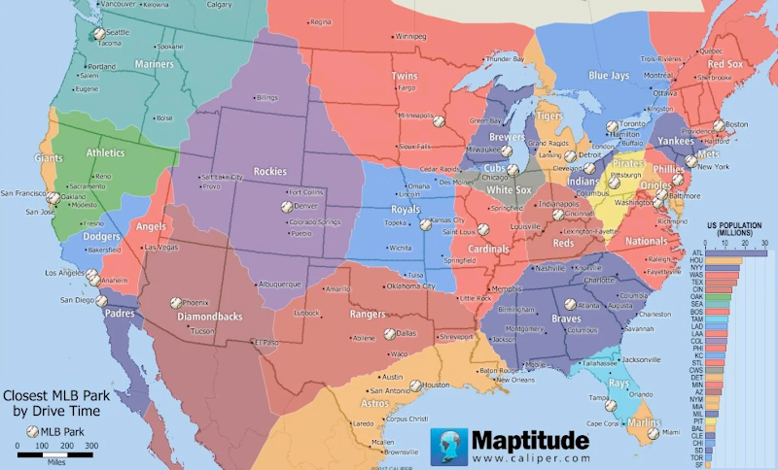
Next Steps
The model was successful in predicting MLB attendance based on income data
Random sampling of residents in new markets to determine interest
Data on city infrastructure (does the city have the capacity to handle a professional sports team?)
Does the city already host another professional sports team?
How do city programs impact expansion plans (SPLOST)
Distance between markets

Slide 28
Works Cited
References
(1) Gendron, Clay. “Us Household Income by ZIP Code 2021-2011.” Kaggle, 14 June 2023, www.kaggle.com/datasets/claygendron/us-household-income-by-zip-code-2021-2011.
(2) “Browse Zillow by State/Province.” Zillow, www.zillow.com/browse/homes/. Accessed 3 July 2023.
(3) “List of All the Major League Baseball Teams.” Baseball Reference, www.baseball-reference.com/teams/. Accessed 2 July 2023.
(4) “Forbes List of the Most Valuable MLB Clubs.” Wikipedia, 2 July 2023, en.wikipedia.org/wiki/Forbes_list_of_the_most_valuable_MLB_clubs.

